Slide 1
3D measurement based on computational photography fusing Passive stereo method and Depth from focus
Student Seminar (2018/10/26)
Regional Planning and Information Lab
M2 Kajihara Yuki

Slide 2
Contents
1
Overview of my research
Background and Objective
Light field camera and its characteristic
Framework
Progress over three months
Plan from now on
Notes:
今後の展望はこのようになっています。

Slide 3

Background and Objective
2
Increasing needs for low cost and accurate 3D measurement
Application areas：automatic driving, monitoring, entertainment
3D measurement using conventional camera
Device：Digital camera
Method：Passive stereo method (using images from different aspects)
Depth from focus (using images with different focus )
Img. 5
Img. 4
Eyes 2
Eyes 1
Img. 3
Img. 2
Img. 1
Img. 2
Img. 1
Camera 1
Camera 2
Passive stereo method
Depth from Focus

Slide 4
Background and Objective
3
Disadvantage of using digital camera
Needs multiple shots or multiple cameras
Multiple shots：Takes much time / Invalid for moving objects
Multiple cameras：Calibration for each camera takes time / Errors
Disadvantage of passive stereo method
In case of repeating patterns on surface, matching ambiguity occurs
Disadvantage of Depth from focus
If brightness is too high, error occurs
Objective of this research
Using a special camera which gives us many kinds of images by one shot and combining passive stereo method and Depth from focus, improve 3D measurement

Slide 5
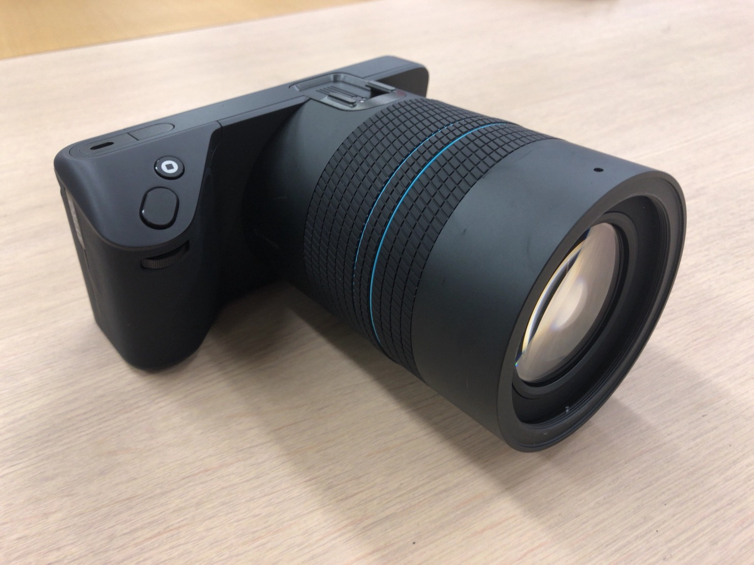
Light field camera and its characteristic
4
Light field camera：Lytro Illum
History：A company named Lytro in the U.S started to sell in 2012
Place micro-lens-array between main lens and sensor
Light from object forms an image on micro-lens-array and is divided into rays on ray sensor
Ray sensor
Micro-lens array
Main lens
Lytro Illum
Structure of Lytro Illum

Slide 6
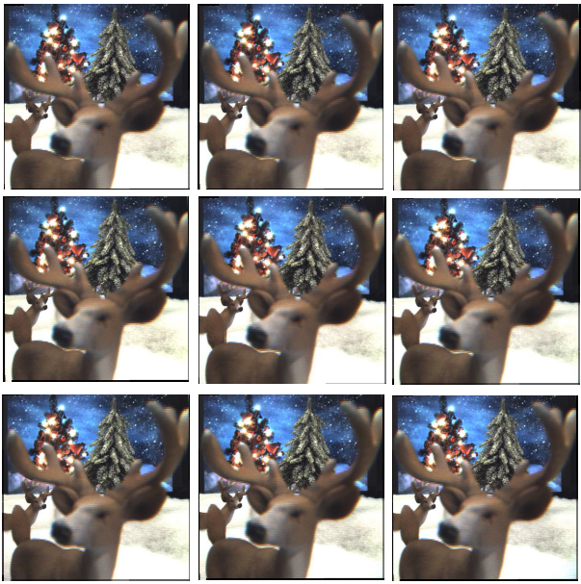
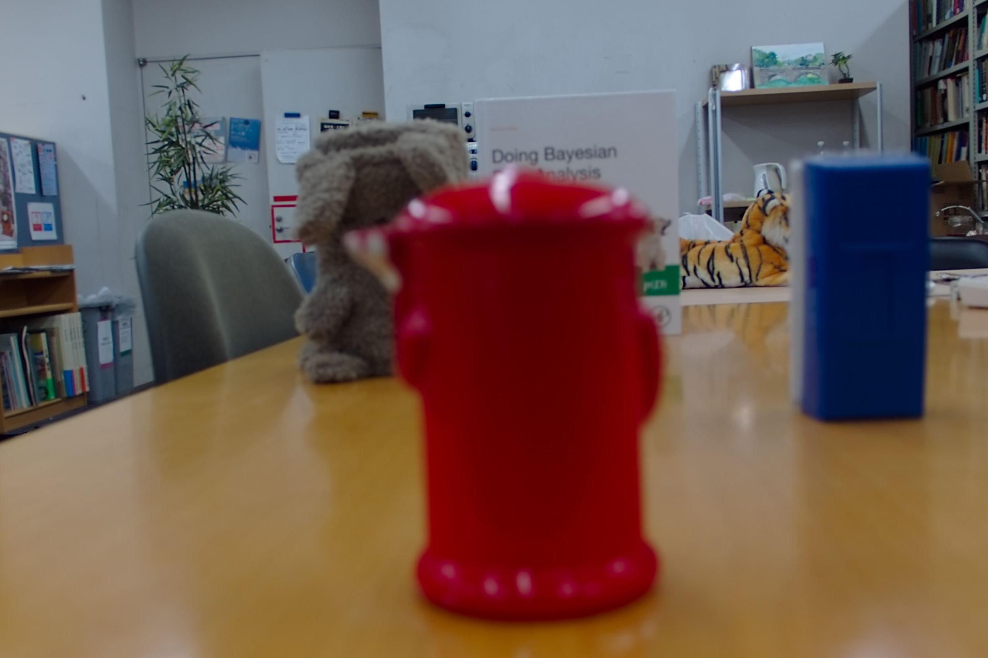
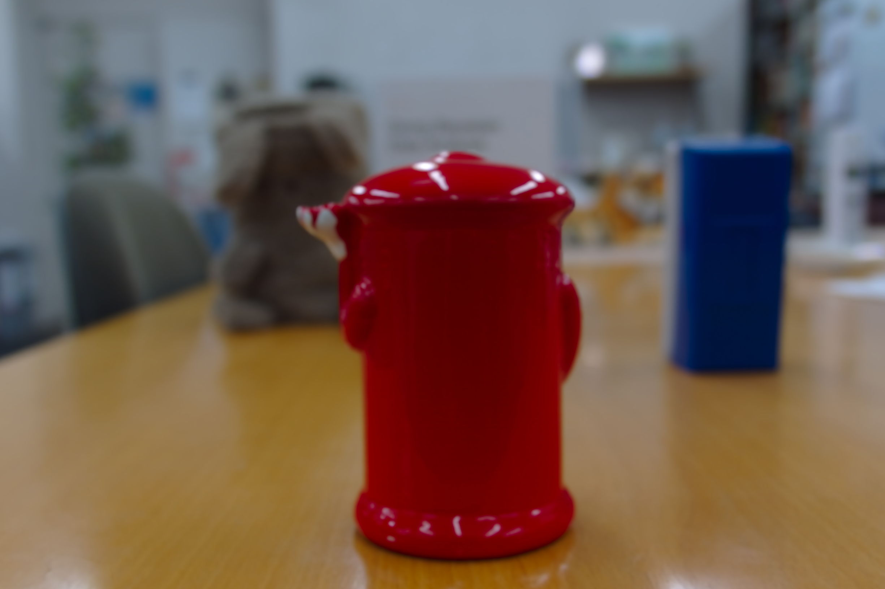
Light field camera and its characteristic
5
Image from processing raw data
Multi-aspect image：Multiple images from slightly different aspects
Multi-focus image：Multiple images with slightly different focus
Near Focus Far
Multi-aspect image
Multi-focus image
http://www.cc.kyoto-su.ac.jp/~kano/pdf/study/student/2013HishinumaPaper.pdf

Slide 7
Framework
6
.lfr image
Decode
Demosaic
Rearrange
.png image
Rearrange
Rearrange
.png images from different aspects
.png images from different focuses
SIFT and feature matching
3D window Laplacian
Parallax of each feature point
depth of each point
Matching cost ( Cs )
Matching cost ( Cf )
Stereo method
Depth from focus
3D coordinates
3D coordinates
Square : data
Circle : Processing
Optimize
3D coordinates
of feature points

Slide 8
Framework
7
.lfr image
Decode
Demosaic
Rearrange
.png image
① Change the light field data into easy-to-handle form

Slide 9
Framework
8
.lfr image
Decode
Demosaic
Rearrange
.png image
Rearrange
.png images from different aspects
SIFT and feature matching
Parallax of each feature point
Matching cost ( Cs )
Stereo method
3D coordinates
② 3D measurement using images from different aspects

Slide 10
Framework
9
.lfr image
Decode
Demosaic
Rearrange
.png image
Rearrange
Rearrange
.png images from different aspects
.png images from different focuses
SIFT and feature matching
3D window Laplacian
Parallax of each feature point
depth of each point
Matching cost ( Cs )
Matching cost ( Cf )
Stereo method
Depth from focus
3D coordinates
3D coordinates
③ 3D measurement using images with different focuses

Slide 11
Framework
10
.lfr image
Decode
Demosaic
Rearrange
.png image
Rearrange
Rearrange
.png images from different aspects
.png images from different focuses
SIFT and feature matching
3D window Laplacian
Parallax of each feature point
depth of each point
Matching cost ( Cs )
Matching cost ( Cf )
Stereo method
Depth from focus
3D coordinates
3D coordinates
④ Extract 3D coordinates
by Minimizing cost
Optimize
3D coordinates
of feature points

Slide 12
Progress
11
.lfr image
Decode
Demosaic
Rearrange
.png image
Rearrange
Rearrange
.png images from different aspects
.png images from different focuses
SIFT and feature matching
3D window Laplacian
Parallax of each feature point
depth of each point
Now Coding
Matching cost ( Cs )
Matching cost ( Cf )
Stereo method
Depth from focus
3D coordinates
3D coordinates
Color : finished coding
Gray : not yet
Optimize
3D coordinates
of feature points

Slide 13
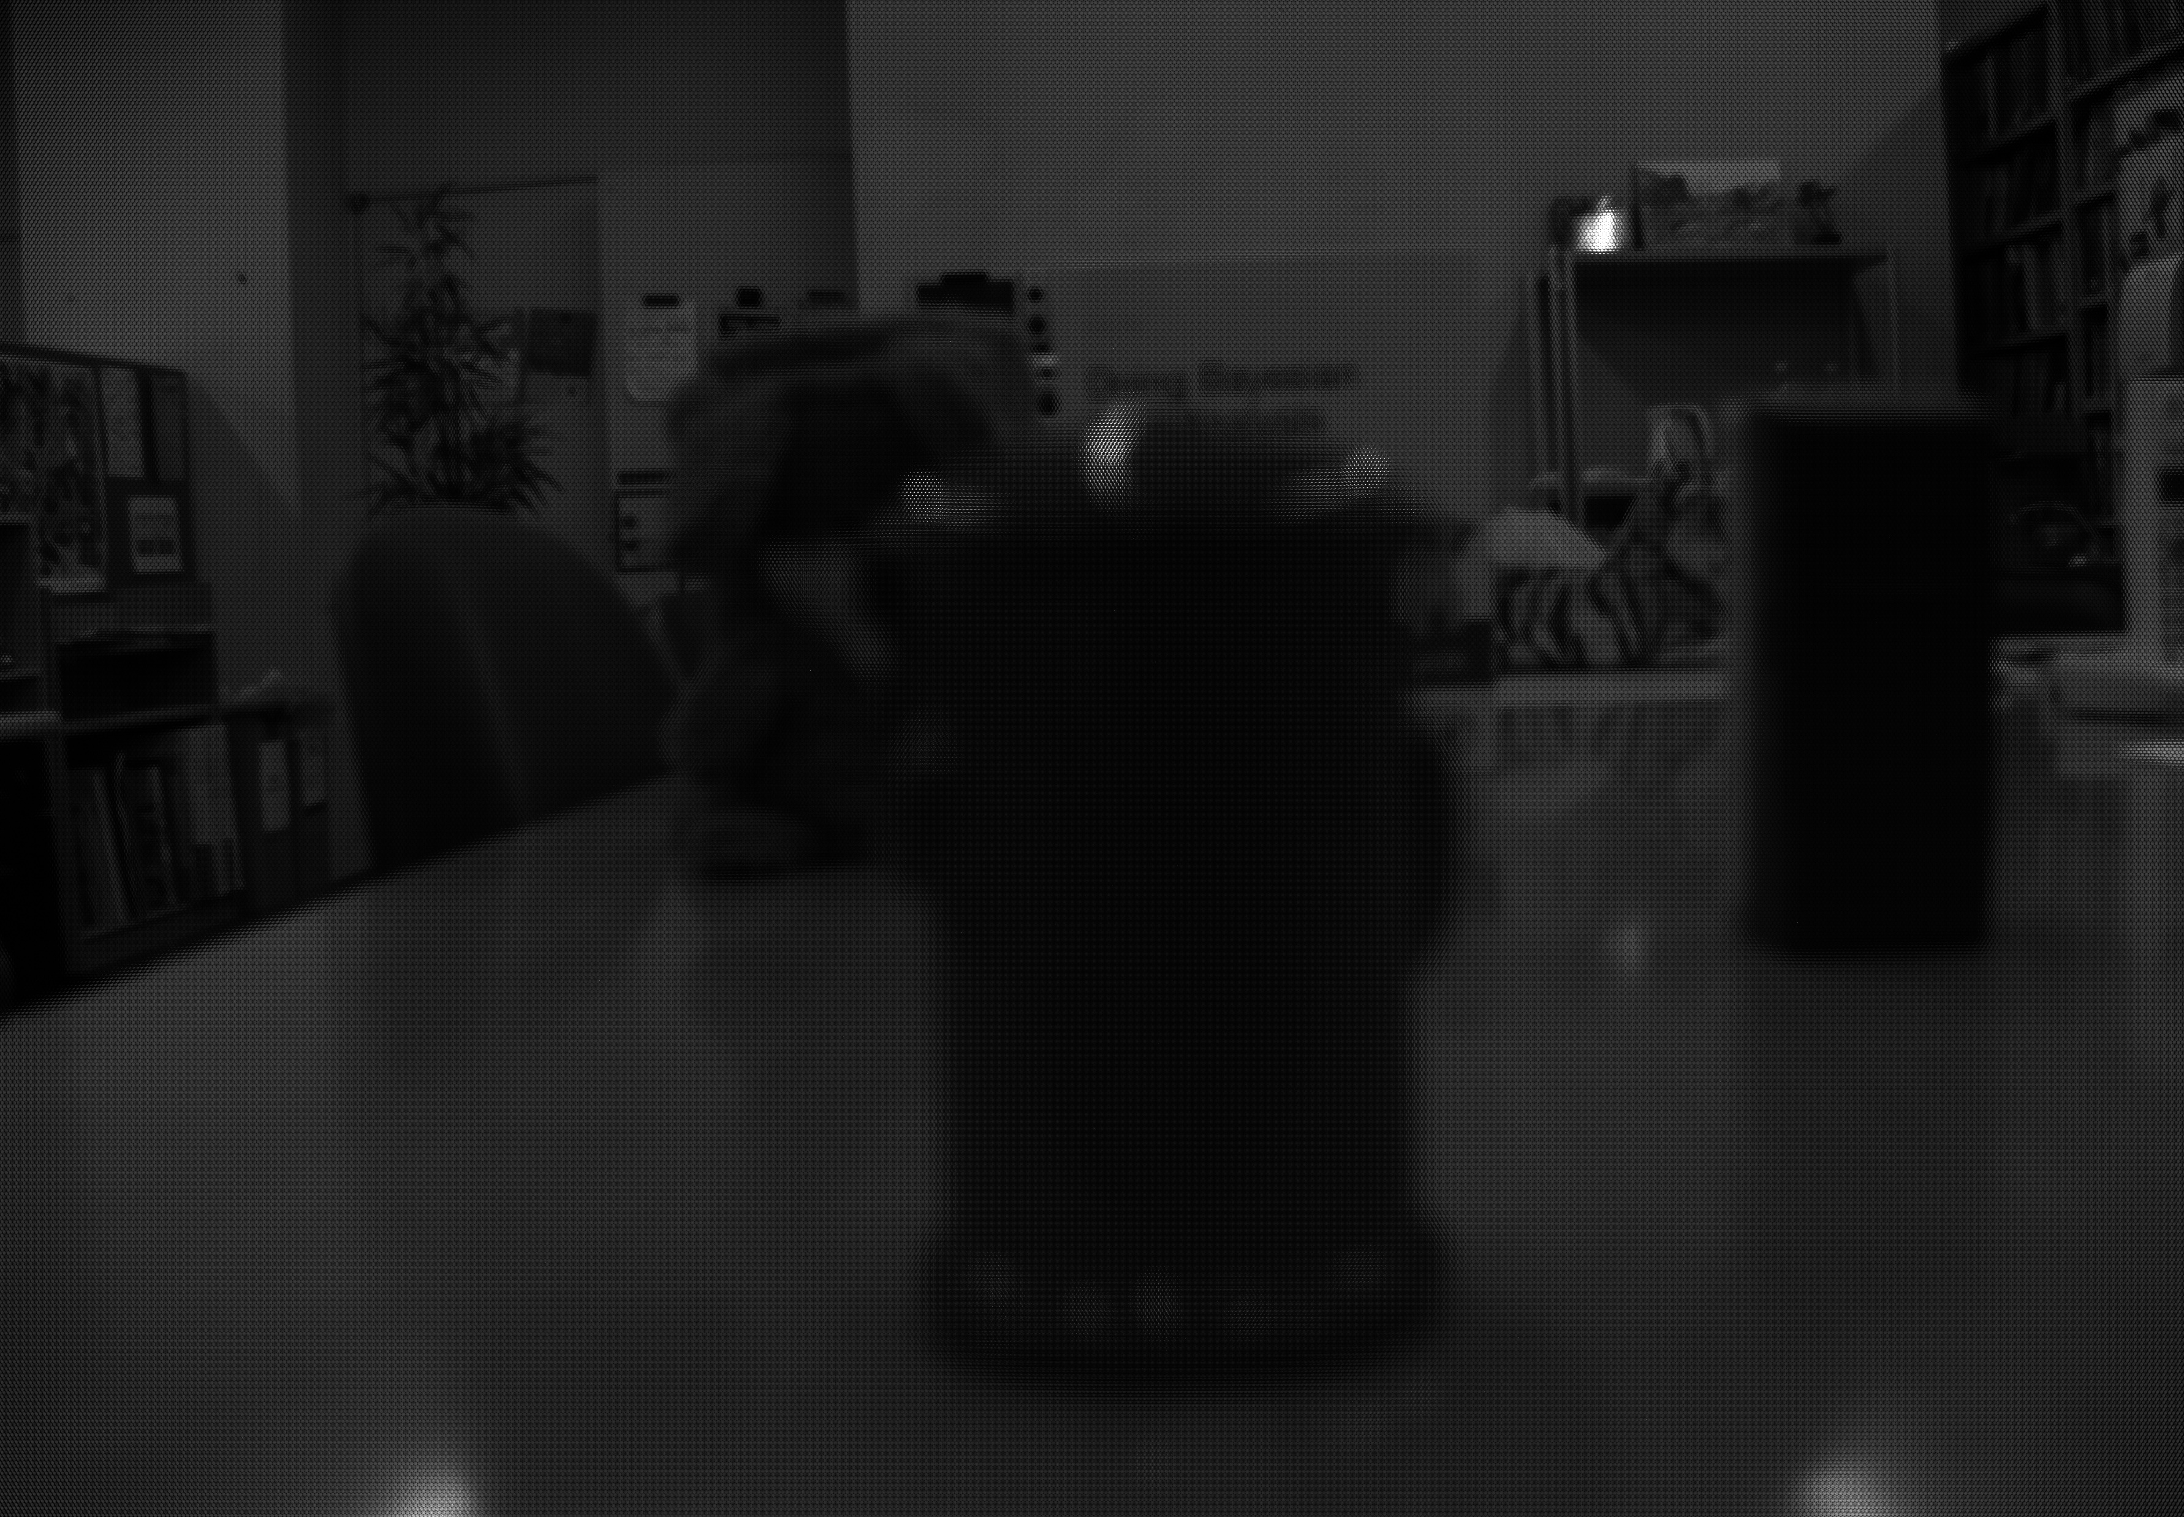
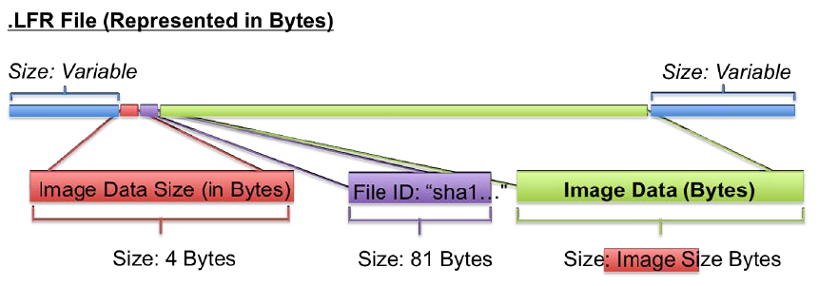
①Change the light field data into easy-to-handle form
12
1. Decode .lfr file
.lfr image
Decode
Demosaic
Rearrange
.png image
.lfr file
Decoded image
・Binary data
・need reverse engineering
・Gray image
・7728×5368 pixels

Slide 14
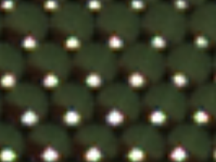
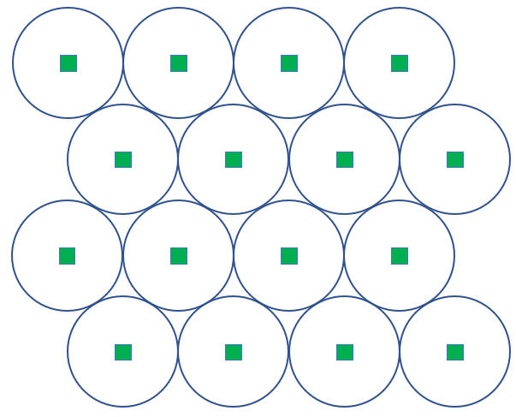
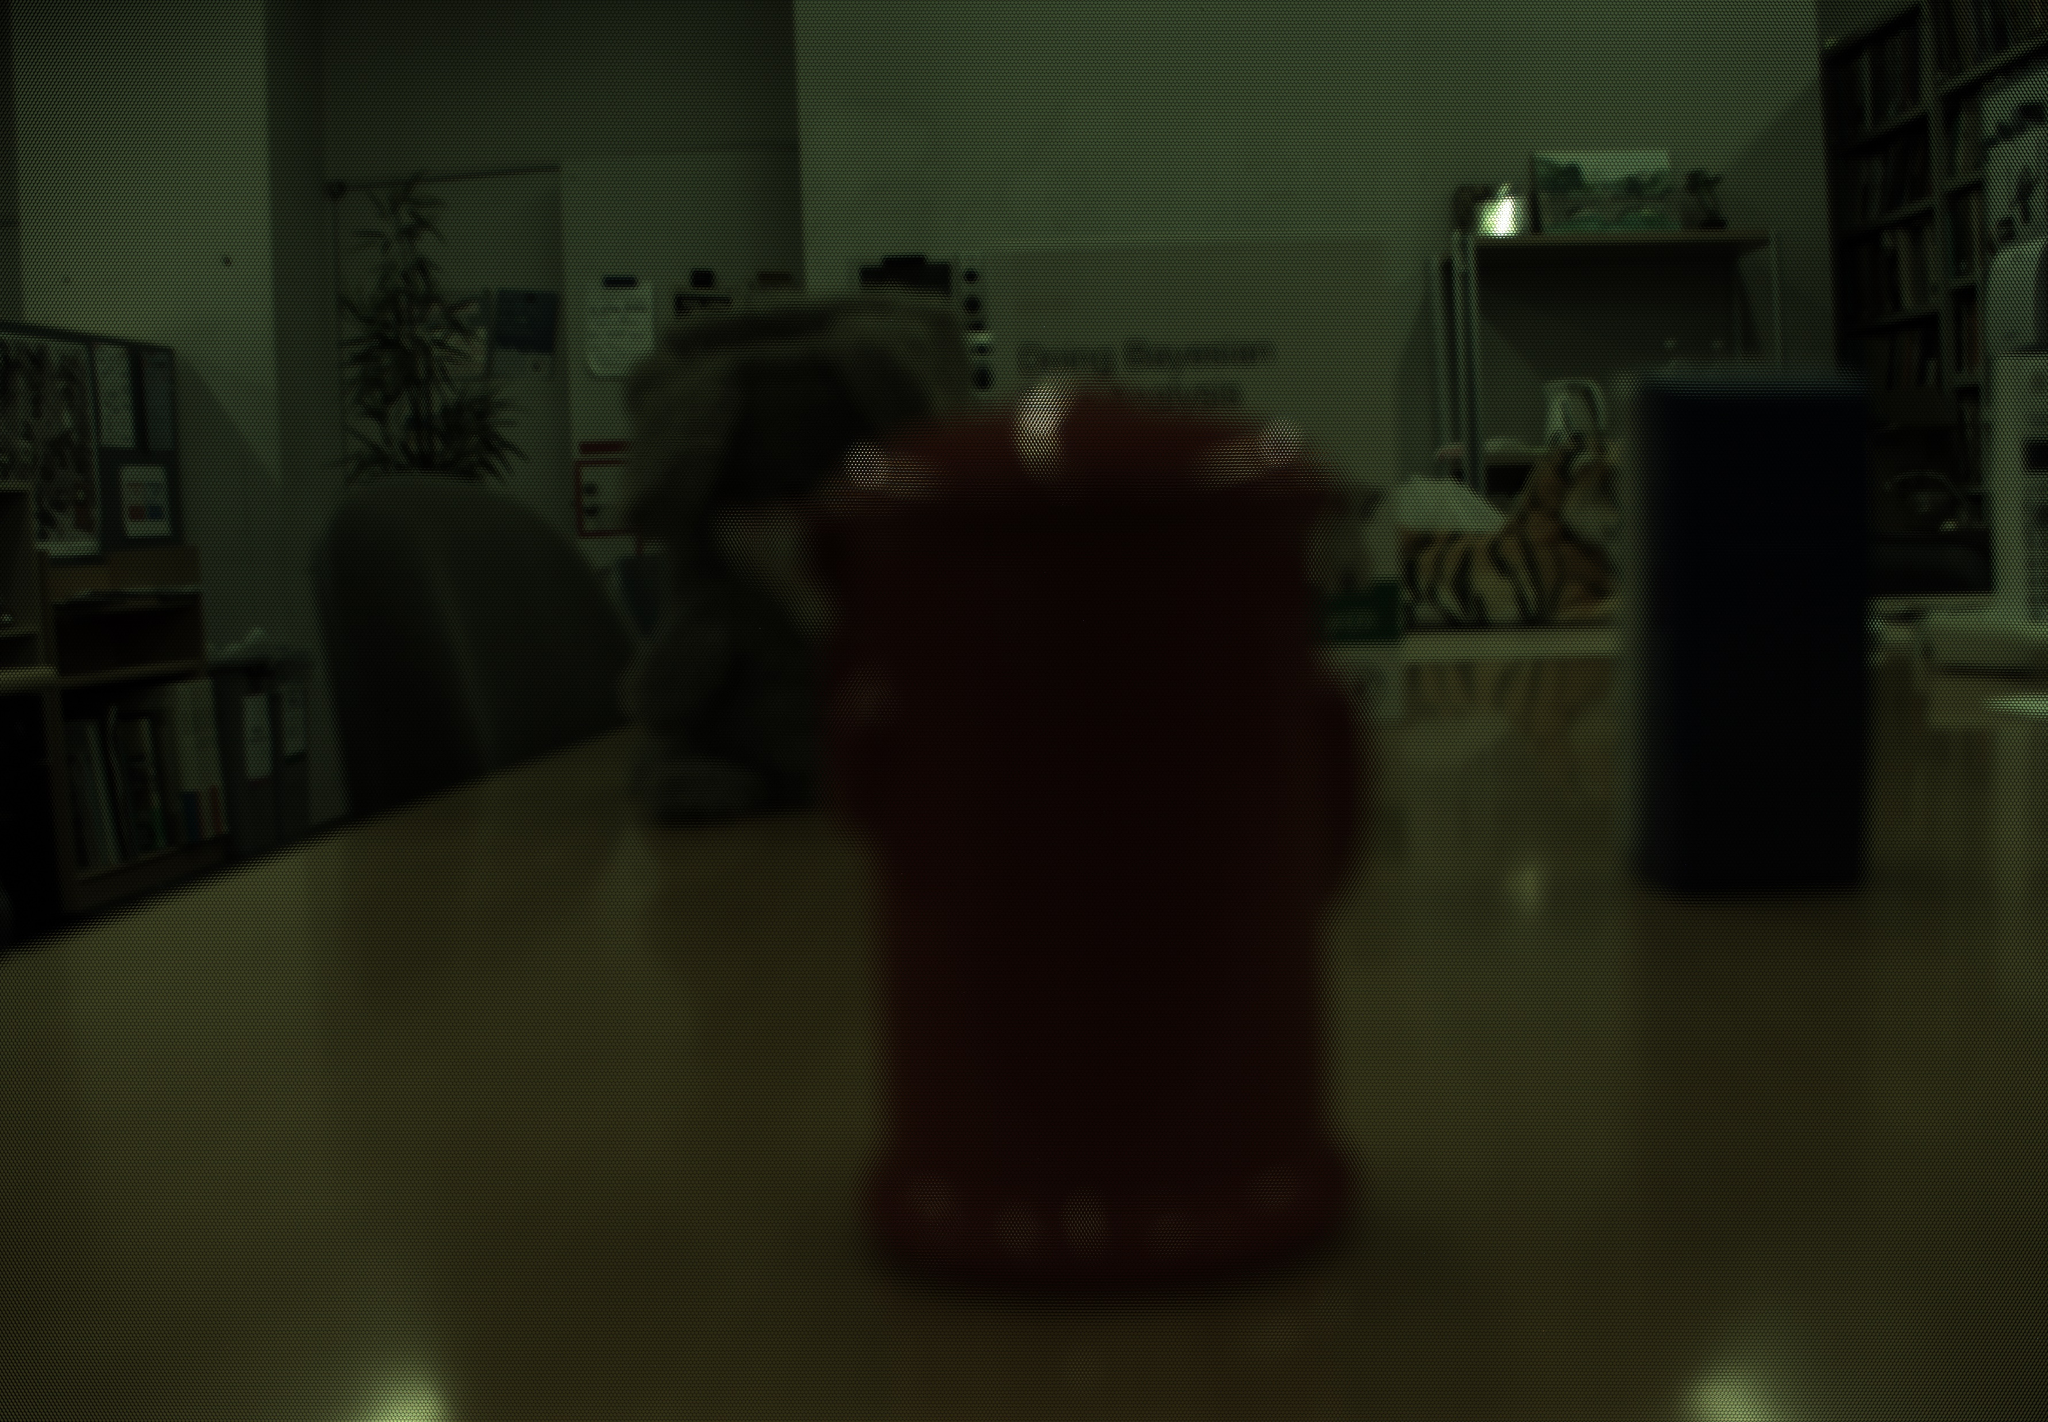
①Change the light field data into easy-to-handle form
13
2. Demosaic the image
.lfr image
Decode
Demosaic
Rearrange
.png image
・Lens placement is different
depending on even / odd row
・hard to handle when computing
Decoded image
Demosaiced image

Slide 15
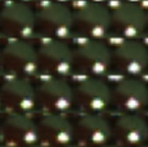

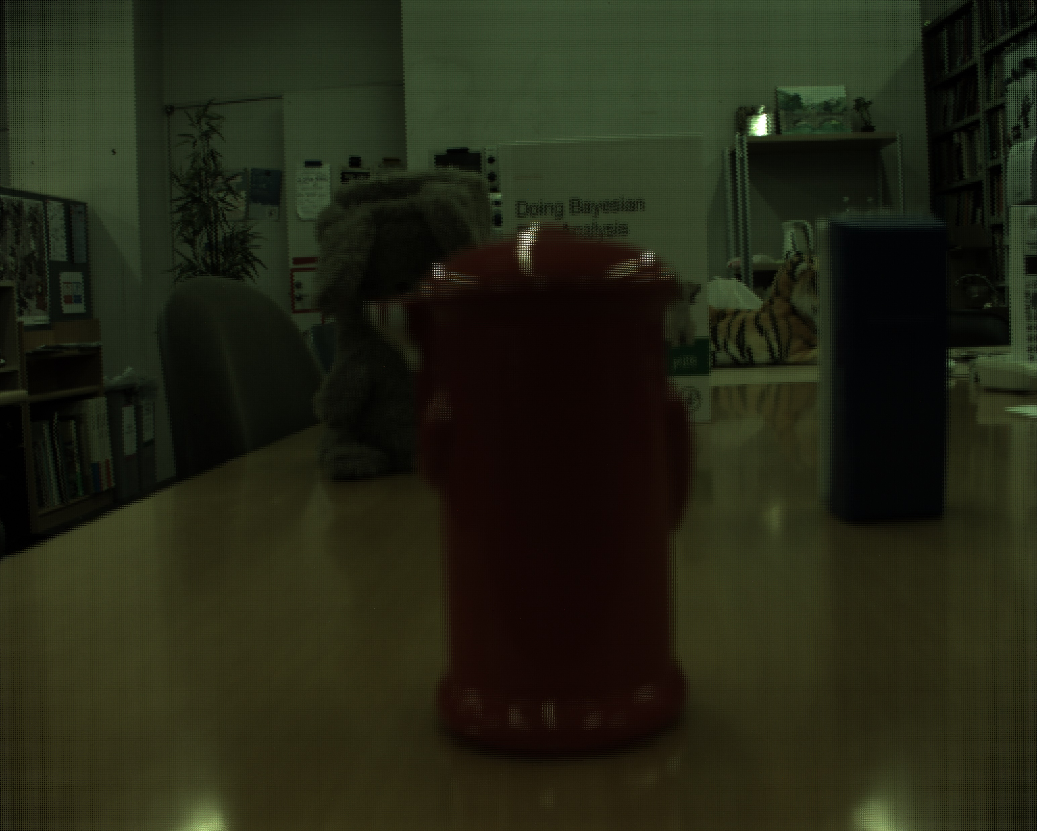
①Change the light field data into easy-to-handle form
14
3. Rearrange the image
.lfr image
Decode
Demosaic
Rearrange
.png image
Based on coordinates
of centers of micro-lens
Demosaiced image
Rearranged image
・Gray image
・7728×5368 pixels
・Gray image
・5929×4752 pixels
Notes:
So, the next step is rearranging the image.

Slide 16
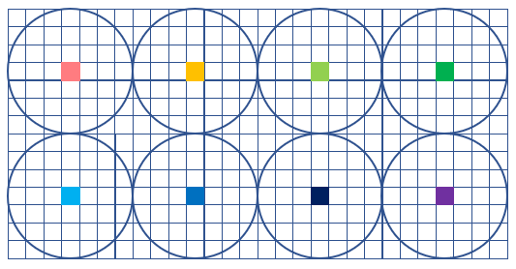
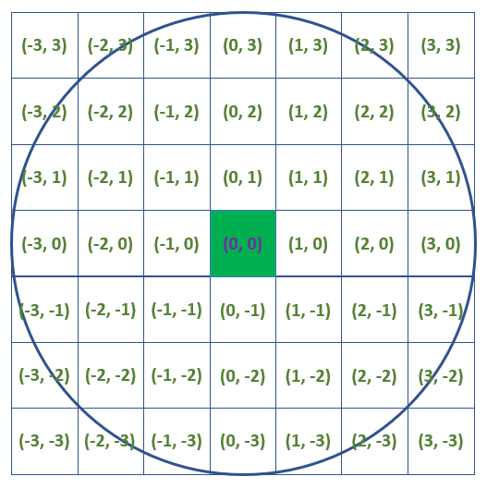
②3D measurement using images from different aspects
15
1. Rearrange the image
.lfr image
Decode
Demosaic
Rearrange
.png image
Rearrange
.png images from different aspects
SIFT and feature matching
Parallax of each feature point
Matching cost ( Cs )
Stereo method
3D coordinates
Pick up and rearrange pixels according to
its relative coordinates from the center

Slide 17
②3D measurement using images from different aspects
16
Slide show of obtained images ①Vertical

Slide 18
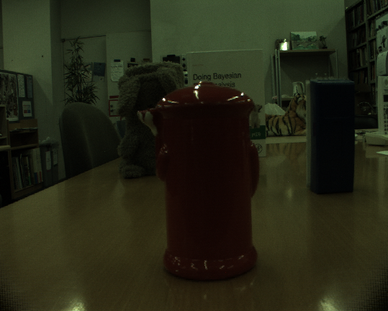

Slide 19
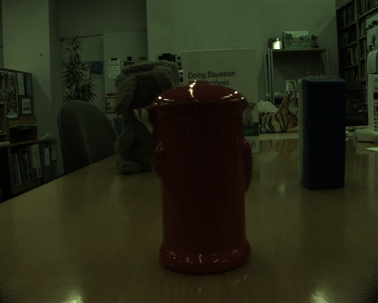

Slide 20
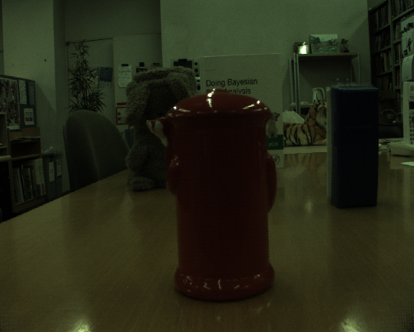

Slide 21
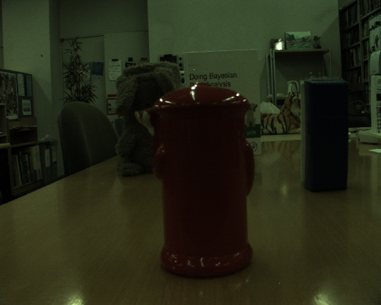

Slide 22
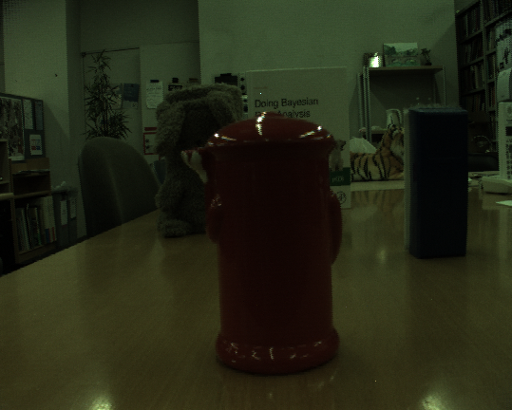

Slide 23
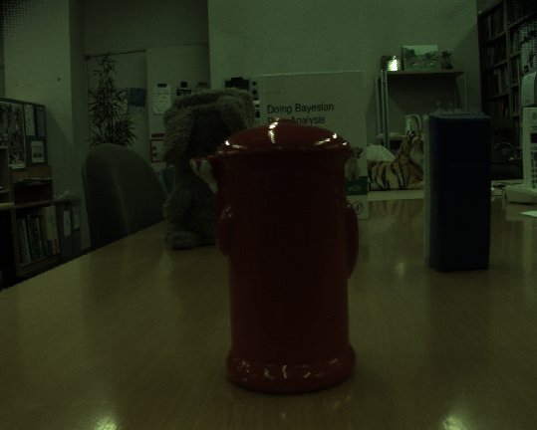

Slide 24
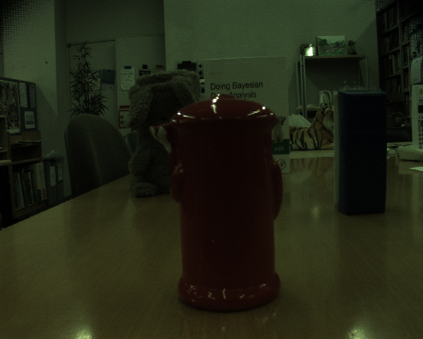

Slide 25
②3D measurement using images from different aspects
17
Slide show of obtained images ②Horizontal

Slide 26
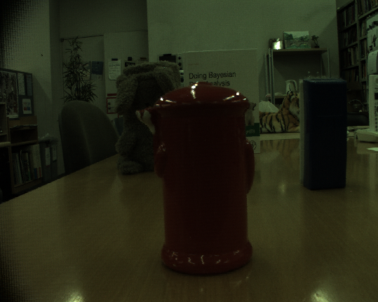

Slide 27
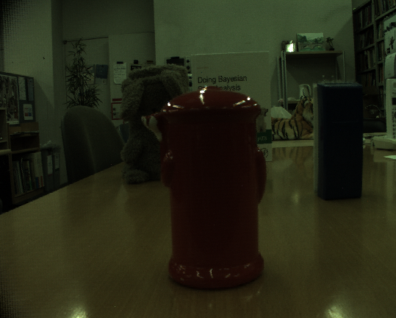

Slide 28
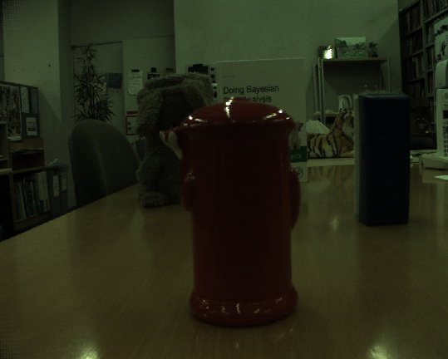

Slide 30
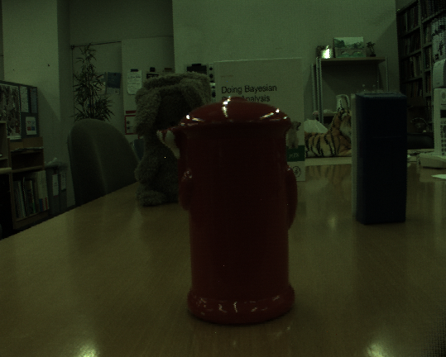

Slide 31
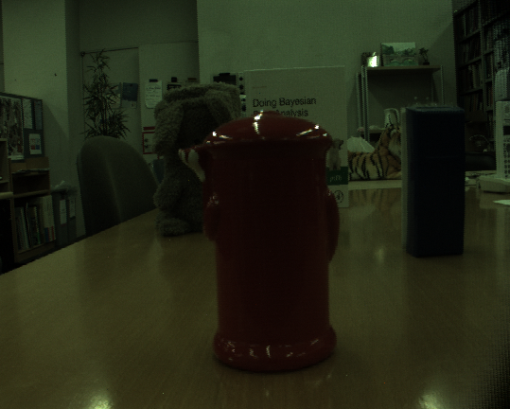

Slide 32
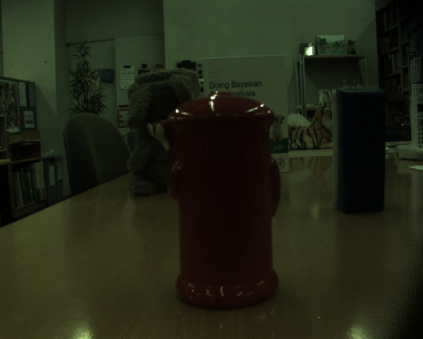

Slide 33
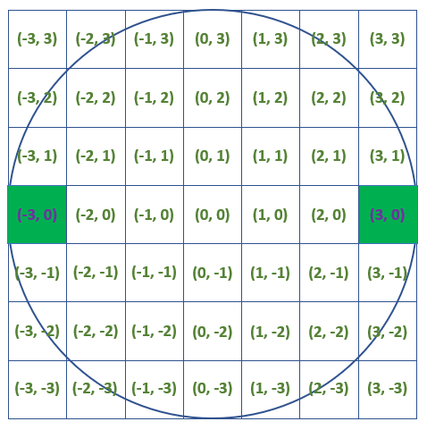
②3D measurement using images from different aspects
18
2. SIFT and feature matching
.lfr image
Decode
Demosaic
Rearrange
.png image
Rearrange
.png images from different aspects
SIFT and feature matching
Parallax of each feature point
Matching cost ( Cs )
Stereo method
3D coordinates
As a trial, use images from
(-3, 0) aspect and (3, 0) aspect images

Slide 34
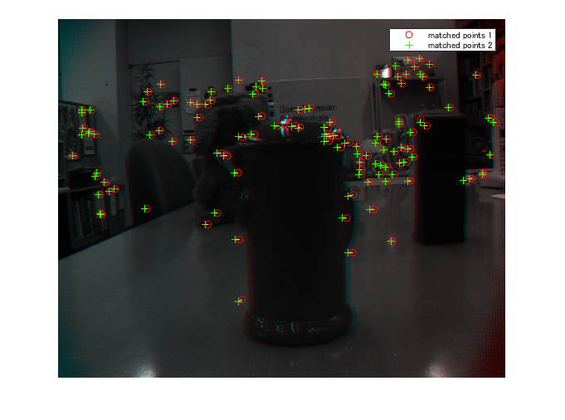
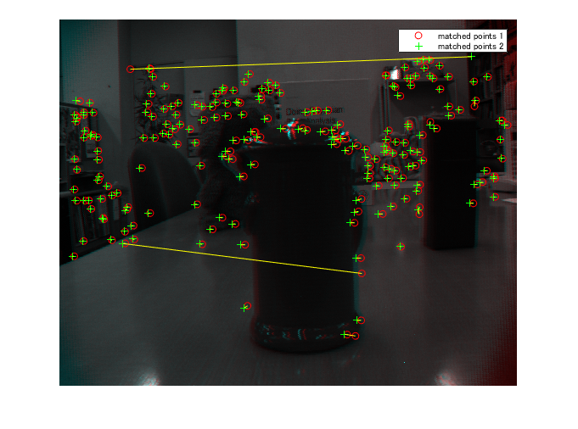
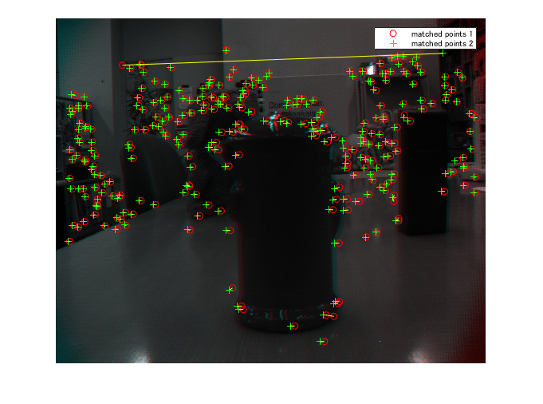
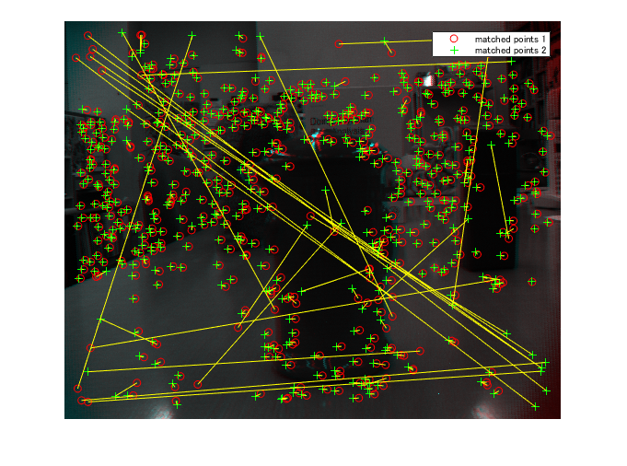
②3D measurement using images from different aspects
19
2. SIFT and feature matching
Threshold: ①>②>③>④
①
②
③
④

Slide 35
Plan from now on
20
.lfr image
Decode
Demosaic
Rearrange
.png image
Rearrange
Rearrange
.png images from different aspects
.png images from different focuses
SIFT and feature matching
3D window Laplacian
Parallax of each feature point
depth of each point
Matching cost ( Cs )
Matching cost ( Cf )
Stereo method
Depth from focus
3D coordinates
3D coordinates
Continue coding…
Optimize
3D coordinates
of feature points

Slide 36
5

Slide 37
Computational Photography
EX1
New field aiming to get all visual information of 3D scenes
：Computational Photography
History：Appeared in 1990s and drastically has developed in 3 decades
Characteristic：Redefine all process of imaging
Advantages：Adding to visual information from digital camera, we can
get depth and extend dynamic range by one shot
Field of Computational Photography
Field of Conventional Photography
Object
Sensor
Processing → Image
Lens

Slide 38
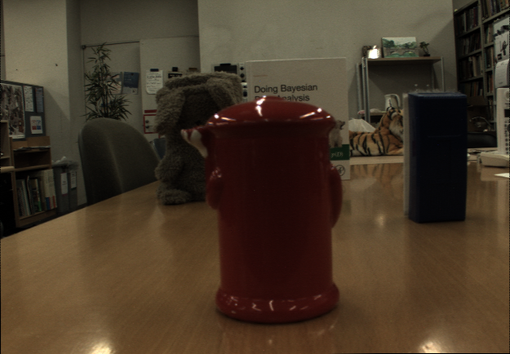
Light field camera and its characteristic
EX2
Basic information about Lytro Illum
Number of ray sensor：7728 × 5368
Number of pixels of output image：2450×1634
The content of raw data(.lfr) from Lytro：Color value of each sensor
Image from raw data of Lytro Illum
Raw image
2450 pixels
1634 pixles

Slide 39
Light field camera and its characteristic
EX3
Image from processing multi-focus image
Everywhere-focused image：Image with focus on every pixels
Multi-focus image
Everywhere-focused image

Slide 40
Image Processing using Lytro Illum
EX4
Principle of getting raw image
Light ray from each point of an object is recorded on ray sensor
covered by micro-lens-array
For each micro-lens, average values of ray sensor and generate an
image focusing on the object → Raw image
Main lens
Micro-lens-array
Notes:
次に、画像の生成方法について説明します。物体の各点から発する光線は、マイクロレンズがカバーするいずれかの画素に記録されます。この図の場合は、ろうそく下部の赤い光が一番上のマイクロレンズアレイで結像し、その後方の3つの画素にそれぞれ記録されます。他の6つの点についても同様です。物体に焦点を合わせた画像の生成は、各マイクロレンズのカバーする画素の値を平均することで行われます。

Slide 41
Image Processing using Lytro Illum
EX5
Principle of getting multi-aspect image
Can get multiple images from slightly different aspects by one shot
An image that sensors at the same position with respect to micro-lens
are arranged is a sub-aperture image seeing objects from a part of lens
When we say the number of ray sensor per micro-lens N, we can get
N multi-aspect image
Aspect1
Aspect2
Aspect3
Lens
Micro-lens-array
Notes:
また、冒頭で述べたように、少しずつ視点の違った多視点画像を生成することもできます。各マイクロレンズに対して同じ位置の画素を再配列すると、レンズの一部から被写体を観察した画像が得られます。この図の場合は、それぞれのマイクロレンズの一番下の画素を追うことで、レンズ上部の赤い点線で囲われた領域からろうそくを見た図が生成されます。他の2つの視点についても同様です。このように、マイクロレンズ当たりの画素数に応じて、異なる視点の画像を得ることができます。

Slide 42
Image Processing using Lytro Illum
EX6
Principle of getting multi-focus image
Can get multiple images with slightly different focus
Light rays which pass the pencil in the figure is recorded on ray
sensors covered by different micro-lens
By averaging, we can get an image with different focus from with
when we took the picture
Lens
Micro-lens-array
Notes:
さらに、ライトフィールドカメラはピントの異なる画像を事後的に生成することもできます。例えば、この図はろうそくにピントを合わせた時の撮影状況を表していますが、前方に鉛筆があった場合、白丸を通過する光線は青い矢印で指された画素に記録されます。これらの画素値を平均することで、鉛筆にピントの合った画像を得ることができます。

Slide 43
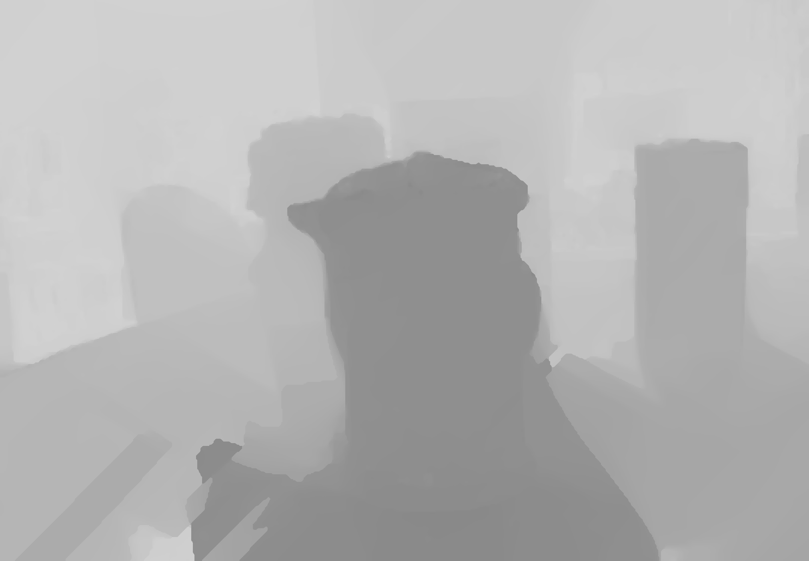
Study of method (Tentative)
EX7
Framework
Shot
and get raw data
Get multi-aspect image
Get multi-focus image
Depth estimation by triangulation
Depth estimation by evaluation of focus
Depth map
Integrate results
Choice
・Weighted average
・Peak ratio
・Markov random
field
Output Depth map

Slide 44
Related works with passive stereo method and depth from focus①
EX8
Frese et al. (2006)
Device：Camera array of 3×3 digital cameras
Shot：Shoot 9 camera with different focus at the same time
Flamework：
Step. 1
Shot
Step. 1
Step. 1
Get multi-aspect image
Get multi-focus image
Step. 2
Step. 4
Depth estimation by triangulation
Depth estimation by evaluation of focus
Step. 3
Step. 5
Energy minimization problem
Verification of depth
Step. 6
Step. 7
Energy minimization problem
Output Depth map

Slide 45

Related works with passive stereo method and depth from focus①
EX9
Step 3. Energy function about diaprity：E stereo (f)
E stereo (f) = E data (f) + E smoothness (f) + E visibility (f)
f ：Disparity when P in img. i has correspondence with Q in img. j
E data (f)：Square error of Intensity of P and Q
E smoothness (f)：
(Disparity between A and B when P has correspondence with A and B) minus
(Disparity between A and B when Q has correspondence with A and B)
E visibility (f)：Infinity when f is physically impossible
Disparity：α
A
A’
B
P
Q
Img. 1
Img. 2
Img. i
Img. j

Slide 46
Related works with passive stereo method and depth from focus①
EX10
Step 6.
Verification of the value of Step.4 based on the value of Step.3
Based on the depth with passive stereo method from Step.2 and Step.3,
Verify the depth with depth from focus from Step.4 in terms of distance
between the base (In the following case, accuracy is P2>P3>P1)
Step 7.
Solve the new energy minimization problem： E fusion (f)
E fusion (f) = E stereo (f) + E focus (f)
E focus (f)：More accuracy, the smaller the value.
C3
P2
Camera (look at C2)
C2
P1
C1
P3
π1
π2
π3

Slide 47
Related works with passive stereo method and depth from focus②
EX11
Tao et al. (2013)
Device：Lytro Illum
Flamework：
Step. 1
Shot
Get multi-aspect image
Get multi-focus image
Generate and shear EPI
Depth estimation by correspondence
Depth estimation by
focus analysis
Output depth map
Combine by MRF

Slide 48
Plan from now on
EX12
Continue to review related works and methods
Re-consider about method
Improve the method of Frese et al. (2006) and Tao et al. (2013)
or completely different ways
Coding
Application of method
Capture scenes in environments where verification by actual distance
measurement is possible
Evaluate accuracy of method
Compare with passive stereo method, Depth from Focus,
the method of Frese et al. (2006) and Tao et al. (2013)
Notes:
今後の展望はこのようになっています。

